Slide 1
Soft Body and Fluid Dynamics Plug-In for Unity Game Engine
Project ID : 16-018

Slide 2
Background
Game development industry
Game engines
Rigid bodies
IT13 0013 08

Slide 3
Existing Systems
IT13 0013 08

Slide 4


Slide 5


Slide 6


Slide 7




Slide 8
Research Problem
Most software use particle based simulation model for fluid renderings for accuracy, which occupy a lot of rime to render.
Real time rendering is a problem.
IT13 0013 08

Slide 9
Why Shapeless?
IT13 0013 08

Slide 10
Objectives
Producing a plug-in for a video game engine to handle soft body deformations.
Open sourcing the plug-in for independent developers to carry on research.
Producing a component to handle simple fluid dynamics in real time for video games.
IT13 0013 08

Slide 11
Specific Objectives

Slide 12
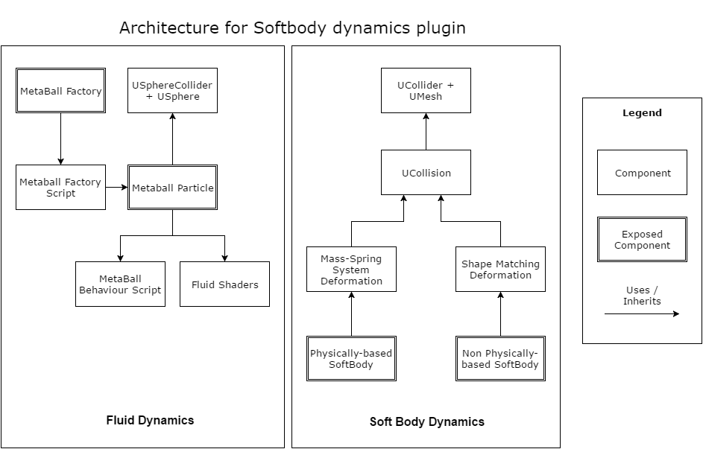
Component Level Architecture Diagram

Slide 13
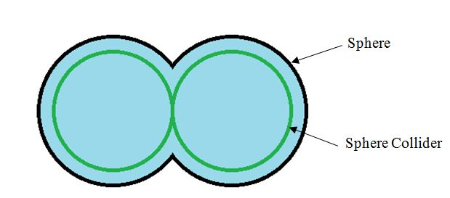
Metaballs
Notes:
Dasni-
Particle based method
Grid based method (fair trade off between performance and realism)
-fluid as a grid where each particle is represented as single cell. More resolution, more visuals at the expense of render time.
So performance over particle based method is not worth the poor interactions

Slide 14
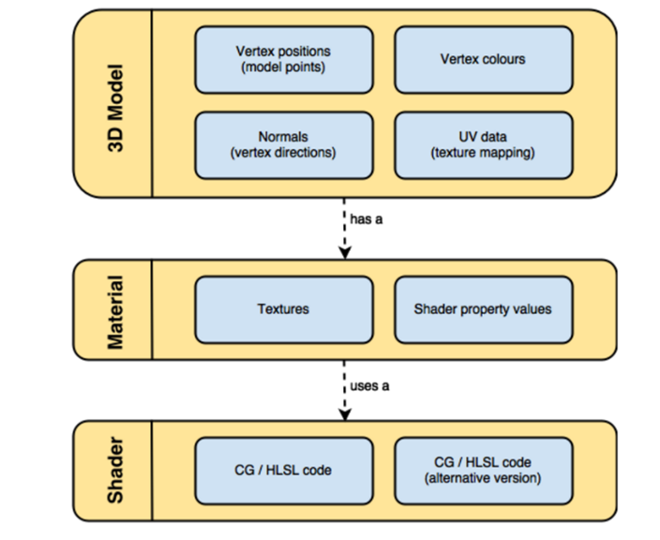
Shaders
Notes:
Particles To be visualized as metaballs
Unity shaders for single particles
For our- consider as one huge blob
Lit and unlit

Slide 15
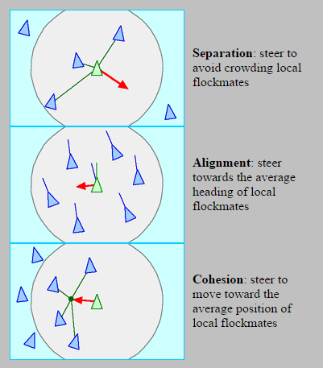
Fluid behaviour

Slide 16
Component Level Architecture Diagram

Slide 17
Methodology
Soft body deformations using mass spring model
Soft body deformation through shape matching
Fluid simulation through metaballs and metaball behaviors.
Metaball factory and shaders.
IT13xxxxxxxx

Slide 18
Users and Benefits
Game developers
Open source plug-in
IT13xxxxxxxx

Slide 19
Expected Outcome
A free plug-in for Unity game engine to handle soft body dynamics and simple fluid dynamics for indie developers.
Mobile yazzdaan
IT13 0013 08

Slide 20
Literature
Terzopoulos, Demetri et al. "Elastically Deformable Models". Siggraph. Pasadena: 1987.
Muller, Matthias et al. "Meshless Deformations Based On Shape Matching". TOG 24.3 (2005): 471. Web. 8 Feb. 2016.
Sharma H. Soft Body Deformation Dynamics Based On Shape Matching. 1st ed. Dorset: 2013.
M. Müller, D. Charypar et al. “Particle-Based Fluid Simulation for Interactive Applications” - Eurographics/SIGGRAPH, San Diego, California, 2003.

Slide 21
Parker, Eric G., and James F. O'Brien. "Real-Time Deformation And Fracture In A Game Environment". Proceedings of the 2009 ACM SIGGRAPH/Eurographics Symposium on Computer Animation - SCA '09 (2009): Web. 12
Teschner, Matthias. "Modeling Dynamic Deformation With Mass Points And Springs". 2003. Presentation. Feb. 2016.
Y. Yu, H. Jung and H. Cho, "A new water droplet model using metaball in the gravitational field", Computers & Graphics, vol. 23, no. 2, pp. 213-222, 1999.

Slide 22
Questions

